Slide 1

MACHINE LEARNING DETECTION OF FOREST FIRES
Nile Coble Week 3 Review

Slide 2
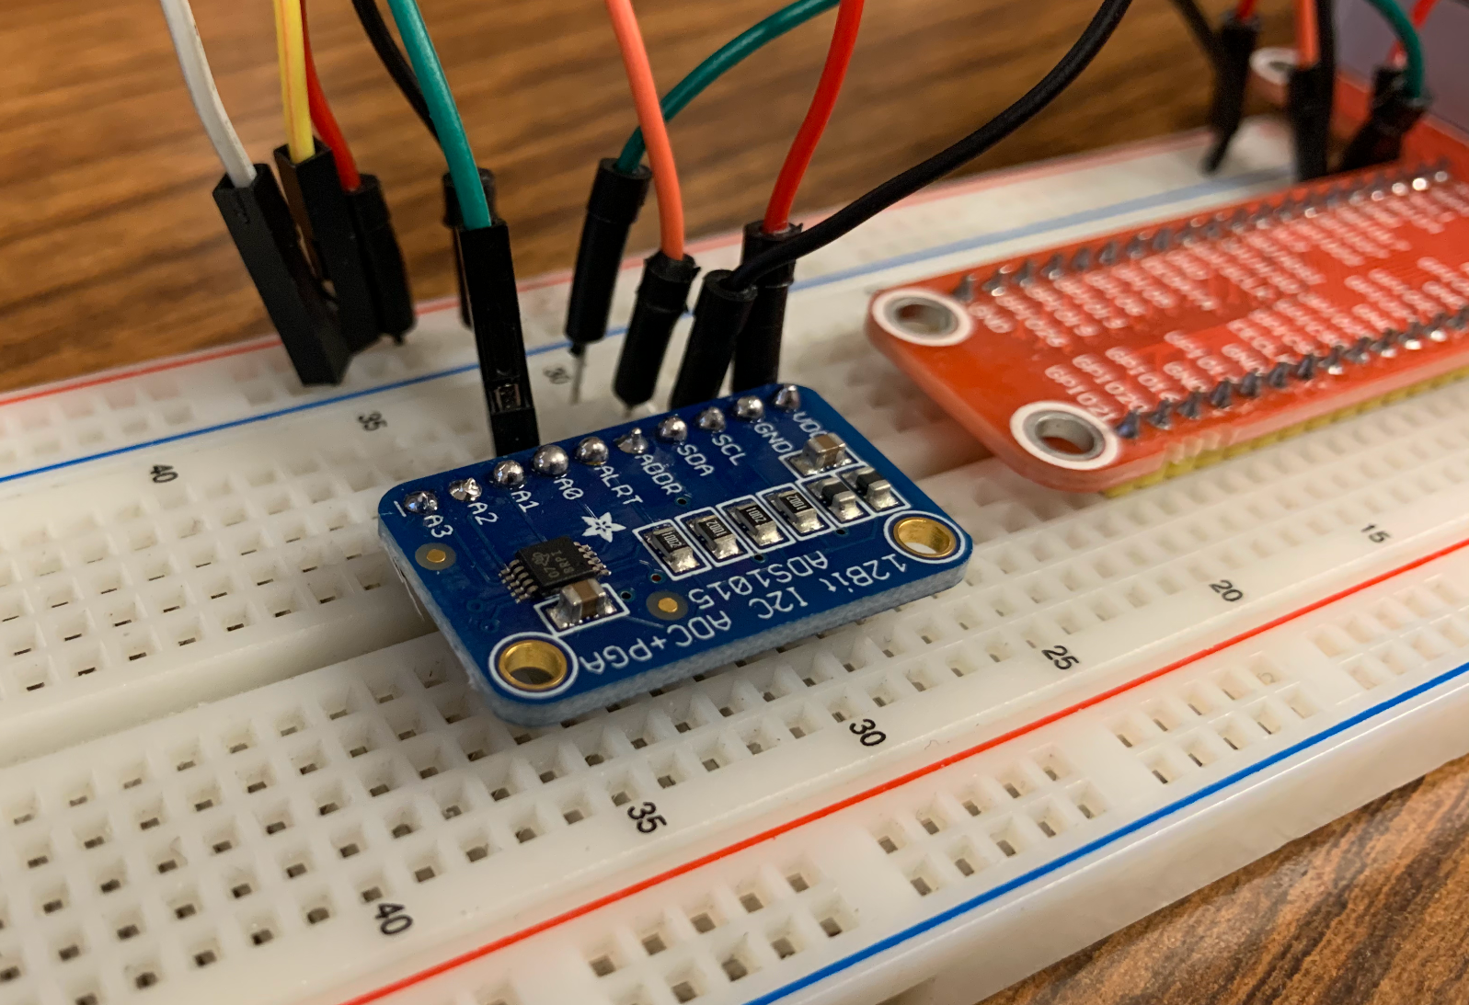
ADC can now sample at 3300 Hz
frames collected: 4763
total frames: 3300
min mV: 479
max mV: 500
range: 22
unique value: 16
skipped frames: 22

Slide 3
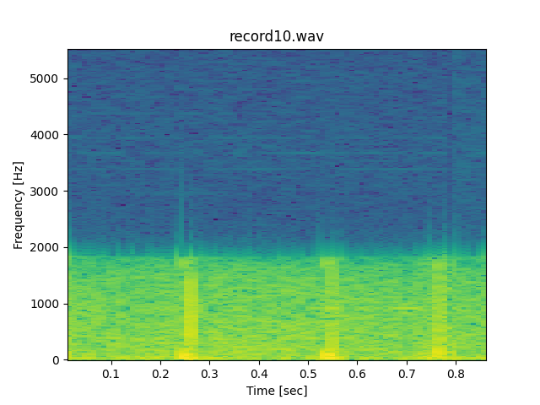
Next Up:
Better microphone
Put model onto the module

Slide 4
THANK YOU

